Slide 1
Why Am I So Tired? Fatigue & Other Invisible MS Symptoms
EMD Serono
Notes:
Thank you for joining us tonight for Why Am I So Tired? Fatigue & Other Invisible MS Symptoms. This Webinar Series is brought to you by Can Do Multiple Sclerosis.
My name is Laura Allen, Associate Director of Programs for Can Do MS. I will be your moderator this evening.

Slide 2
JULY
PROGRAMS
JUMPSTART – July 10
Managing Invisible Symptoms, Part I: Sleep & Fatigue
COACHING – July 14
Caring For Your Energy
JUMPSTART – July 22
Managing Invisible Symptoms, Part II: Temperature Sensitivity, Pain, and Vision Problems
COACHING – July 27
Your Questions, Answered: Invisible Symptoms
CanDo-MS.org
Notes:
Monthly programs slide
Welcome to July. Our theme this month is staying active.
Our monthly programs will continue build on one another with four opportunities to connect with experts and peers. The last session of the month on July 27 will be dedicated to Your Questions Answered on Invisible Symptoms. We can address any unanswered questions you have during this interactive session.

Slide 3
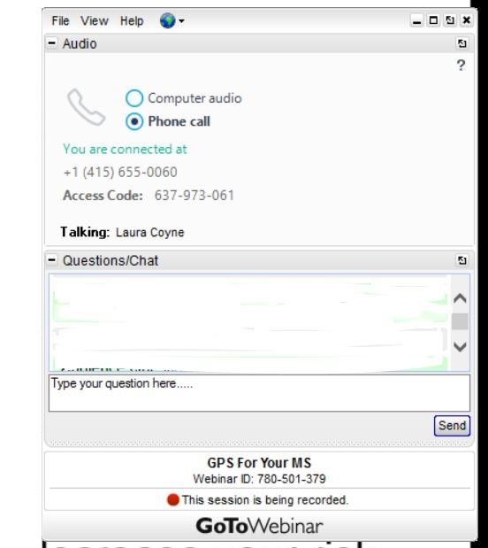
How to Ask Questions During the Webinar
Type in your questions using the Questions/Chat box
Notes:
We will save about 20 minutes at the end of this webinar for questions and answers. If you have a question during the presentation you can type it in using the Questions box found in your control panel.
This presentation is being recorded and will be archived on Can Do MS website.
You can download a copy of tonight’s presentation and additional resources from your control panel.

Slide 4
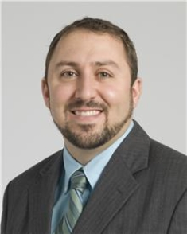
Matthew Sacco, PhD
Psychologist
Independence, OH
Notes:
Our speakers tonight are Matt Sacco and Tracy Walker.
Matt is a psychologist with the Cleveland Clinic. He works with people with a wide range of neurological and other health conditions.

Slide 5
Tracy Walker, FNP-C, WOCN
Nurse Practitioner
Atlanta, GA
Notes:
Tracy is a Nurse Practitioner who has specialized in treating MS at the Shepherd Center in Atlanta for The last 26 years. She has recently retired from Shepherd to pursue some new adventures. In addition to her new adventures she also works part time performing health and safety evaluations for elderly and disabled clients in their homes.
And now I am going to turn the meeting over to Matt.

Slide 6
Learning Objectives
Recognize that many of MS’s most common & impactful symptoms are invisible, including fatigue, depression, cognitive dysfunction, spasticity and pain.
Overview of how MS creates these symptoms & common treatment/management strategies
Impacts of invisible symptoms on support partners & tips to communicate about invisible symptoms
Notes:
Matt

Slide 7
Depression
Cognitive
Dysfunction
Pain
Spasticity
Fatigue
Invisible Symptoms
Notes:
Matt

Slide 8
The Key to Effective Symptom Management is Knowledge and Skills
Learning about symptoms helps you recognize, understand and discuss them
Managing symptoms requires an individualized and flexible approach
Effective management can improve quality of life promote realistic Hope
Notes:
Tracy

Slide 9
Interactive Poll
Which Invisible Symptoms have you experienced?
(Check all the apply or type your answer in the question box)
Fatigue
Spasticity
Pain
Depression
Cognitive Dysfunction
Notes:
Tracy

Slide 10
Fatigue
Symptoms
Most commonly reported symptom in MS - Affects 80-90% of people with MS
Causes and Contributing Factors
Reduced utilization of glucose in the brain
Problems Resulting from Fatigue
Increased Depression
Often the first MS symptom people experience
Over 50% of patients describe fatigue as their worst MS symptom
De-conditioning
Lifestyle Issues
Medications that induce fatigue
Fatigue from disrupted sleep
Depression
Cognition
Pain
Heat
Cognitive Dysfunction
Sexual Dysfunction/ Loss of Libido
Increased pain
Notes:
Tracy

Slide 11
Strategies for Managing Fatigue
Energy Conservation
Regular Exercise
Good sleep habits
Proper Nutrition
Cooling Strategies
Medications
Family education/ Counseling
Notes:
Tracy & Matt

Slide 12
Depression
Symptoms
Depression-one of the most common symptoms of MS
Causes and Contributing Factors
Pre-existing depressive symptoms
Problems Resulting from Depression
Makes other symptoms worse
Can occur at any point in course of disease
More common with MS than general population
Fatigue
Pain
Cognitive difficulties
Reaction to having chronic illness
Direct result of disease processes
Medications
Major life changes
Relationship difficulties
Health Issues
Self-Harm
Notes:
Matt

Slide 13
Strategies for Managing Depression
Exercise
Staying socially connected
Engaging in activities that make you feel good or have made you feel good in the past
Eating Healthy
Get outside
Working with mental health professional
Avoid alcohol and illicit substances
Medication
Notes:
Matt & Tracy

Slide 14
Cognitive Dysfunction
Symptoms
More than half of those with MS likely to develop difficulties
Causes and Contributing Factors
Disease process/progress
Problems Resulting from Cognitive Dysfunction
Slowed processing speed
NOT Alzheimer's or Dementia!
Memory impairment
Impaired attention/concentration
Impaired executive functions
Impaired spatial relations
Impaired word-finding ability
Correlates with Number of lesion/lesion area and atrophy
More likely in Progressive MS
More likely during exacerbation
Medications
Depression & Anxiety (and other mental health issues)
Environmental Factors (too much stimulation)
Alcohol use
Notes:
Matt

Slide 15
Strategies for Managing Cognitive Dysfunction
Effectively managing mental health
Physical Activity
Cognitive Rehabilitation
Stop trying to rely on ineffective strategies
Write lists instead of trying to rely on memorization. There WILL NOT be a test at the grocery store!!
Use your smart phone, calendar, dry erase board, put your keys in same spot
Talk to your health care team about medications that can help or may be interfering with cognitive functioning
Notes:
Matt & Tracy

Slide 16
Spasticity
Symptoms
Muscles are tight and resistant to stretch
Causes and Contributing Factors
Often accompanied by muscle weakness or pain that reduces range of motion leading to more stiffness and spasms
Problems Resulting from Spasticity
Increased energy expansion leading to increased fatigue
Often includes active spasms
May be perceived as painful
Worsens after periods of inactivity such as sleeping, sitting, traveling
MS lesions in the spinal cord
Contractures/ permanent restriction in range of motion leading to difficulty with self care and mobility
Increased pain and weakness
Skin breakdown
Notes:
Tracy

Slide 17
Strategies for Managing Spasticity
Non-Pharmacologic
Stretching
Positioning
Seating
Range of motion
Orthotics
Physical therapy
Pharmacologic
Baclofen (Lioresal)
Tizanidine (Zanaflex)
Gabapentin (Neurontin)
Levetiracetam (Keppra)
Diazepam (Valium)
Botulinum Toxin (Botox)
Surgical
Baclofen Pump
Notes:
Tracy & Matt

Slide 18
Pain
Overview
NARCOMS reported >80% of people with MS experience some type of pain
Symptoms
Acute symptoms
Emotional vs. Physical Pain
“Our bodies use the same neural system to detect and feel pain regardless of whether it is emotional or physical…”
Common cause of disability
Under-recognized and can be inadequately managed
Not well understood and difficult to treat
MS-related pain is multifactorial
Neuralgic pain (trigeminal neuralgia)
Painful optic neuritis
Lhermitte’s syndrome
Neurogenic pain (example: dysesthesia)
Musculoskeletal pain (example: low back pain)
Spasticity/spasms
Chronic symptoms
Professor of Psychology
University of Utah
Dr. Alan Fogel, Ph.D.
Notes:
Tracy & Matt

Slide 19
Strategies for Managing Pain
Medications
Physical/Occupational Therapy- sensory retraining
Counseling, Education
Mind Body Medicine, Relaxation, Stress Management
“Alternative and Complimentary” Therapy :
Acupuncture
Massage Therapy
Notes:
Tracy & Matt

Slide 20
Impact on Relationships
Can affect many types of relationships and in many different ways
Family
Wife/husband/partner
Children
Extended family
Friends
Work
Other social relationships
Communicating invisible symptoms begins with good communication skills
Can Do-Relationships & Communications
Notes:
Matt & Tracy

Slide 21
How to Communicate Your Needs
People most affected day to day
Partner
Make time (not during a crisis)
Attend appointments
Read resources
Attend support groups
Can Do MS Programs cando-ms.org
Children
Age appropriate information
Keep S'myelin-NMSS
Mommy's Story, Daddy's Story
Proactive Communication
Don’t wait for them to approach you
Notes:
Matt

Slide 22
Communicating Needs Beyond Family
To what extent the relationship might be affected by symptoms?
Friends
Who needs to know and what do they need to know?
Close friends
Casual Acquaintances
Work
If/When to disclose (Work Disclosure-NMSS)
Proactive and Interactive Process (Working with MS-Can Do)
Notes:
Matt

Slide 23
Communicating with Your Healthcare Team
Assertive Communication!
Prepared and Proactive
Learn and know yourself and your symptoms
Monitor you experience of invisible symptoms
Make a list of changes as they occur
New symptoms
Worsening symptoms
Tell them about any changes in mood
Ask partner to share what they have noticed
Invisible does not mean imagined and/or untreatable!
Notes:
Tracy

Slide 24
Resources
https://www.nationalmssociety.org/
https://mymsaa.org/
https://www.cando-ms.org/
Notes:
Tracy

Slide 25
Key Take-Aways
Invisible Symptoms are common and can affect one another
Effective management strategies can include a multi-disciplinary wellness approach
Ask for help and use your support system
Notes:
Tracy & Matt

Slide 26
Cited Sources
1 Adapted from: My Cognitive Changes Because of Multiple Sclerosis by Devin Garlit April 13, 2017, https://multiplesclerosis.net/living-with-ms/my-cognitive-changes-because-of-multiple-sclerosis/
2 Adapted from, “Am I Cognitively Impaired” by Prof G, https://multiple-sclerosis-research.org/2021/04/am-i-cognitively-impaired/
3 “Treatment and Management of Cognitive Dysfunction in Patients with Multiple Sclerosis” (Review article by DeLuca, Chiaravalloti, & Sandruff, 2020)
4 “Mindfulness training for emotion dysregulation in multiple sclerosis: A pilot randomized controlled trial” (Schirda et al., 2020)
5 Emotion Regulation Skills Training for People with MS and Support Partners (unpublished study, Hughes, Beier, & Botanov, 2020)

Slide 27
Q&A
Notes:
As a reminder, we will ask you to complete a survey that will pop up on your screen at the conclusion of the webinar. We very much appreciate your input and have included some questions to help us plan for 2022. Please share your feedback with us.
But First! Let’s go through a few questions that were submitted this evening.

Slide 28
Connect With Us
f
Twitter
Facebook
Instagram
@CanDoMS
@CanDoMultipleSclerosis
@CanDoMultipleSclerosis
Notes:
We hope you’ll stay connected! Follow us on social media for the latest programs, resources, and MS news. You can also register for our monthly eNews series by visiting CanDo-MS.org.
I would like to highlight the Exercise Snacks that we are posting across our Social Media platforms. It is a fun way to incorporate a little exercise into your everyday life.

Slide 29
JULY
PROGRAMS
JUMPSTART – July 10
Managing Invisible Symptoms, Part I: Sleep & Fatigue
COACHING – July 14
Caring For Your Energy
JUMPSTART – July 22
Managing Invisible Symptoms, Part II: Temperature Sensitivity, Pain, and Vision Problems
COACHING – July 27
Your Questions, Answered: Invisible Symptoms
CanDo-MS.org
Notes:
Monthly programs slide
Register online or give us a call to register over the phone!

Slide 30
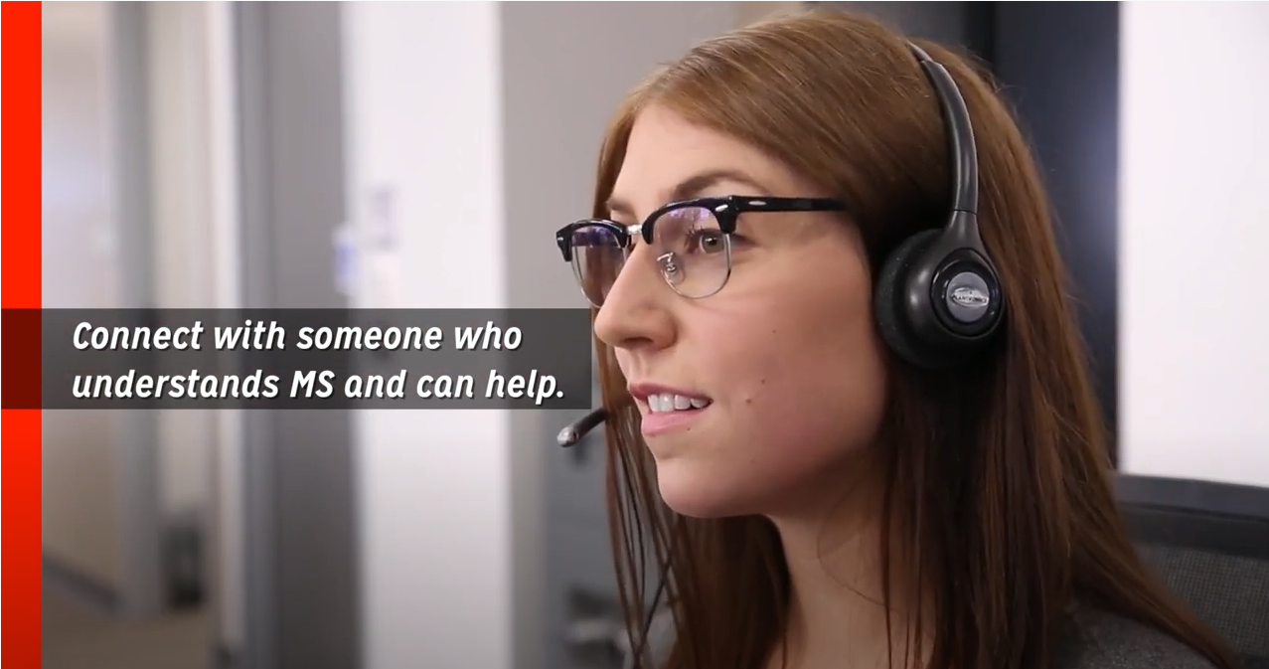
Notes:
Two additional resources that you may find useful are the National MS Society and the MS Society of Canada.
The mission of the National MS Society is to help people affected by MS live their best lives as they stop MS in its tracks, restore what has been lost, and end MS forever. You can explore other Society’s programs, services, resources and connection opportunities at nationalmssociety.org.

Slide 31
New Ways to Manage Your MS
Wednesday, August 4 at 8pm ET
EMD Serono
Notes:
The next WEBINAR WEDNESDAY is - August 4th, at – 8:00 p.m. Eastern Time. That’s the first Wednesday of the month! The topic is Traveling and recreating Safely.

Slide 32
The preceding program is copyrighted by Can Do Multiple Sclerosis. It is provided for your personal educational and referential use only. Any repurposing or dissemination of its content requires the consent by Can Do Multiple Sclerosis.
© Can Do Multiple Sclerosis
Notes:
For those participating live tonight, you will see a survey appear on your computer screen. Please take a moment to complete the survey and share your input. Your feedback helps us continue to improve our Webinar and Series. Thank you for joining us, and have a great evening!

