Slide 1
Issues With Bladder Function in MS
Tracy Walker, NP, WOC

Slide 2
MS and Bladder Function… The not so good news:
Bladder problems are common – approximately 75% of persons with MS have bladder symptoms.
They can impact quality of life.
If left untreated, they can lead to more serious problems.

Slide 3
MS and Bladder Function… The really good news:
Bladder problems with MS
can be treated!
Soooo don’t…..

Slide 4
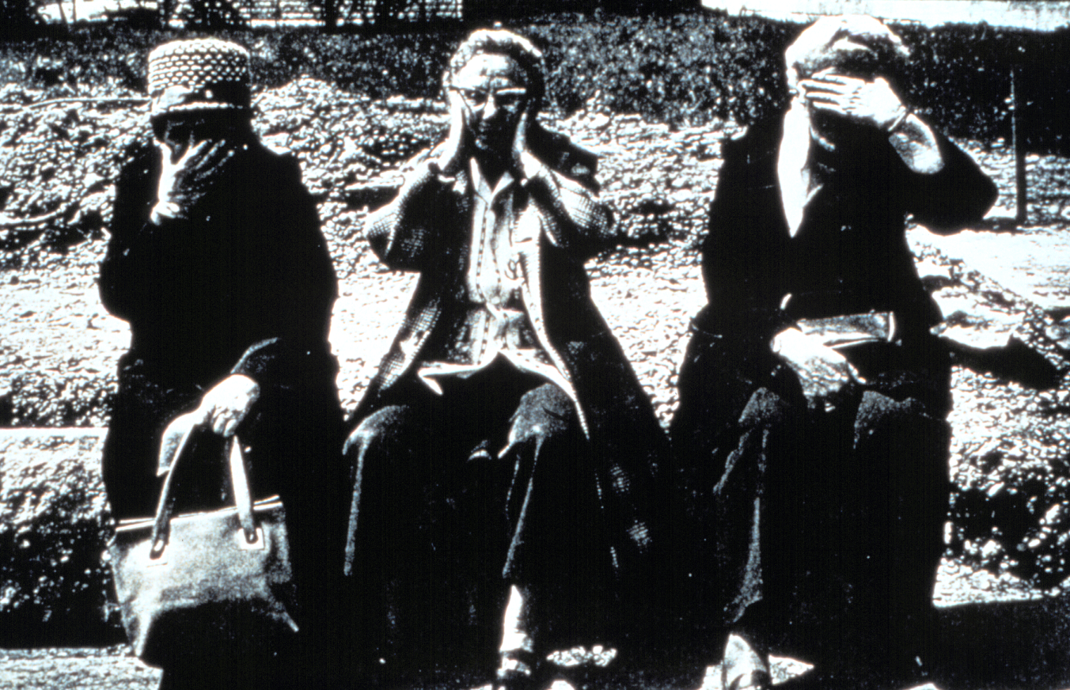

Slide 5
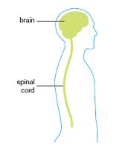
What Creates Bladder Problems?
Lesions in brain and spinal cord.
Cord lesions cause most problems.
Brain lesions cause difficulty with voluntary control.
There is a correlation between disability level and bladder problems.

Slide 6
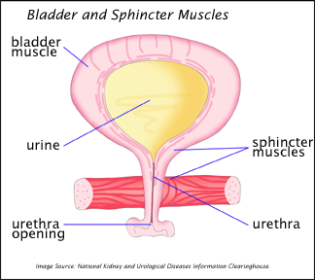
How Does the Bladder Work?

Slide 7
MS Can Cause:
A bladder to empty often - but well
(urgency/frequency )
A bladder to empty partially - but not fully (urinary retention)

Slide 8
Not all bladders are created equal….
Failure to empty
Normal fill
Failure to fill

Slide 9
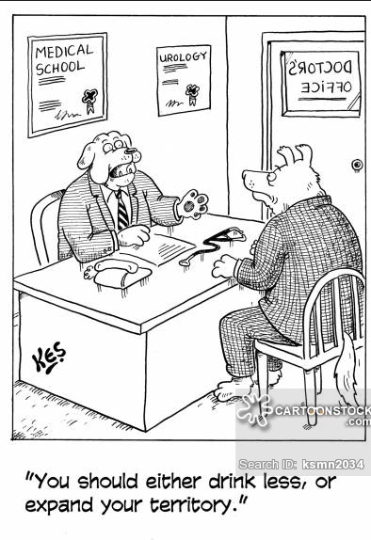

Slide 10
Bladders that don’t fill…
Failure to empty
Normal fill
Failure to fill

Slide 11
Symptoms Some People Experience
If your bladder does not hold much:
Frequency
Urgency
Mild incontinence
Loss of sleep
Inability to be out-and-about without worrying about where bathrooms are located.

Slide 12
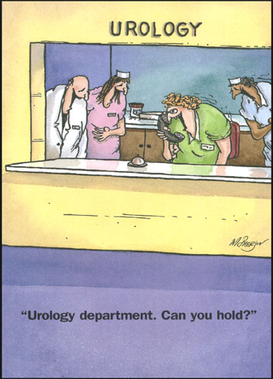

Slide 13
A bladder that can’t empty…
Normal fill
Failure to empty
Failure to fill

Slide 14
Failure to empty:
Over distended
Sphincter unable to open

Slide 15
Symptoms People Experience
If your bladder doesn’t empty well:
Urinary tract infections
Frequency
Urgency with incontinence
Hesitancy
Not feeling empty
Needing to get up at night
Leaking

Slide 16
“If I Have Some of Those Symptoms, What Should I Do?”
Tell your provider
Your provider might:
- Measure the urine in your bladder after going to see what is left (ultrasound)
- Refer you to a urologist
- Refer you for pelvic floor training
- Make suggestions about lifestyle changes
- Prescribe a medication to calm the bladder muscle or relax the sphincter

Slide 17
Goals of Bladder Management
Maintain Renal Function and Prevent Secondary Complications
Mimic normal voiding patterns and provide means for adequate bladder emptying
Reduce Symptoms and Improve Quality of Life
Prevent life threatening complications

Slide 18
“What Would A Urologist Do?”
A Good history
Pelvic examination/prostate examination
Post-void residual - an ultrasound to measure urine left in bladder after voiding
Cystoscopy
Urodynamic studies to see what part of the urinary system is not working well
Recommend other treatments such as botox injections.

Slide 19
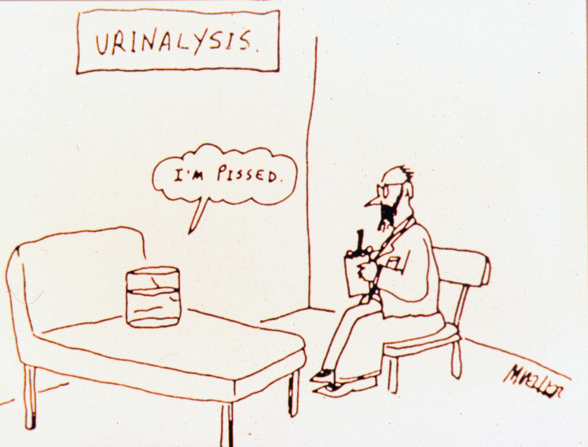

Slide 20
What Happens Then?
If the bladder is not emptying well all the time, it might be recommended that you learn how to empty the bladder by intermittent catheterization.
Doing IC frees you up from having to go frequently, in the night or when you are out and about.

Slide 21
“Why Can’t I just take a pill and be done with it?”
Medications for bladder urgency and frequency help to relax the bladder muscle.
If you empty your bladder well, they can help calm the bladder and decrease urgency/frequency.
If you do not empty your bladder well, they will allow more urine to collect and increase your risk for infections and kidney problems.
Providers can’t tell by history alone whether medications will help or not.

Slide 22
Medications That May Help Manage Bladder Frequency
Sanctura
Vesicare
Toviaz
Myrbetriq
Ditropan XL
Oxybutinin
Detrol LA
Oxytrol

Slide 23
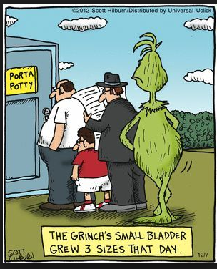

Slide 24
Medications to loosen the sphincter
Flomax
Cardura

Slide 25
Lifestyle Change Suggestions
Drink adequate fluids
- Drinking in larger amounts less often may decrease frequency
Inadequate fluids will concentrate the urine
causing bladder irritation
Alcohol irritates the bladder
Aspartame may irritate the bladder
Some foods affect some people’s bladders
Double voiding, timed voiding.

Slide 26
Botox: What does it do?
Injections into bladder muscle cause small areas to be inactive- decreasing urgency/frequency.
Botox will need to be repeated every few months.
The bladder may not be able to empty as well after Botox, so catheterization may be needed after treatment.

Slide 27
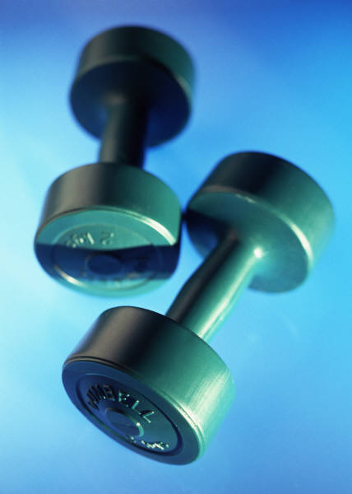
“What is Pelvic Floor Training?”
Guided by a therapist who works in this area, you can learn to strengthen the sphincter in the bladder to allow you to have more control over loss of urine
Bladder training can help you get to the toilet, in from the car, and to the rest stop.

Slide 28
The End…
Questions?

Slide 29
